Slide 1
A DNA-based, Biomolecular Cryptography Design
Jie Chen;
Circuits and Systems, 2003. ISCAS '03. Proceedings of the 2003 International Symposium on
Volume 3, 25-28 May 2003 Page(s):III-822 - III-825 vol.3
Presented by Jian-Fu Dong

Slide 2
Abstract
Recent research has focused on DNA as a medium for ultra-scale computation and for ultra-compact information storage. Unlike using the conventional electronic means to encode data, we propose a novel design of DNA-based, molecular cryptography design in this paper. Due to the random nature of DNA, we can make our cryptography in principle unbreakable. Carbon nanotube-based message transformation, and DNA-based cryptosystem are proposed. To demonstrate the performance, we present an interesting example to encode and decode images using the proposed scheme.

Slide 3
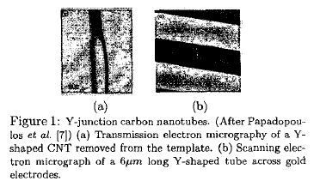
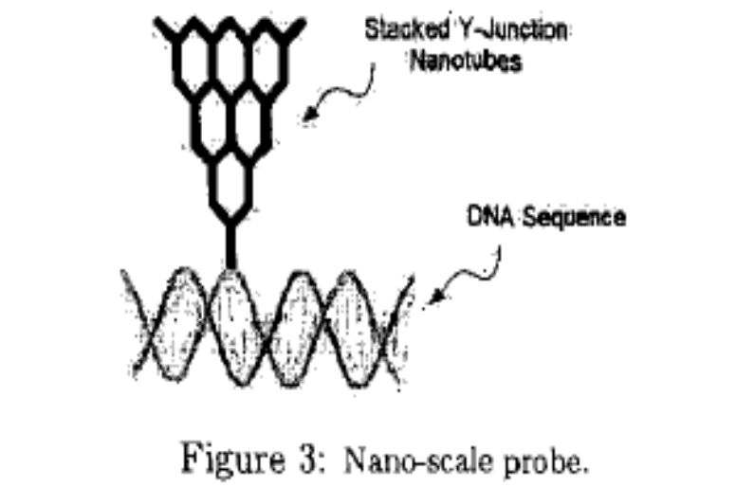
Carbon Nanotube-based Probe
Using Y-junction carbon nanotubes(CNT) for our DNA encoded data write-in/read-out.

Slide 4
Biomolecular Cryptosystem
Input : short segments of distinct
plaintext messages.
Assemble a large one-time-pad in the form of a DNA strand, which is randomly assembled from short oligonucleotide sequences.
Isolate and Clone the DNA strand

Slide 5
One-time-pad encryption
One-time-pad encryption uses a random codebook to convert short segments of plaintext messages to encrypt text.
Codebook must be truly random, and they must be used only once.

Slide 6
Cryptography Mechanism
M: a plaintext binary message
n : message length( how many bits )
K : added message
C : Output cipher message
Encrypt : C_{i} = M_{i} + K_{i} ( 1≦ i ≦n)
(ex : 1011 = 0110 + 1101)
Decrypt : M_{i} = C_{i} + K_{i} ( 1≦ i ≦n)
(ex : 0110 = 1011 + 1101)

Slide 7
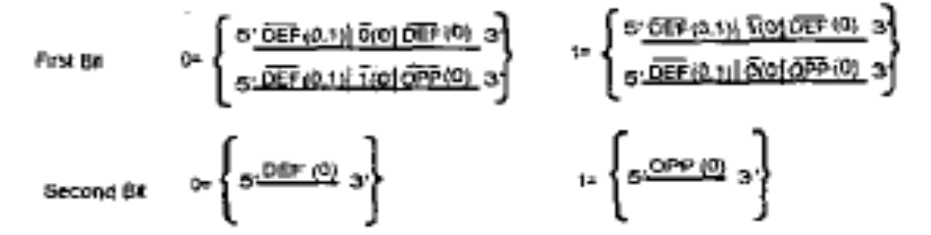
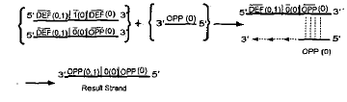
DNA-based Addition(1)

Slide 8
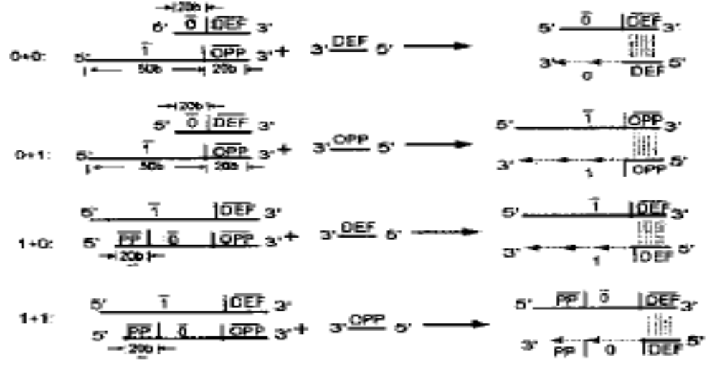
DNA-based Addition(2)

Slide 9
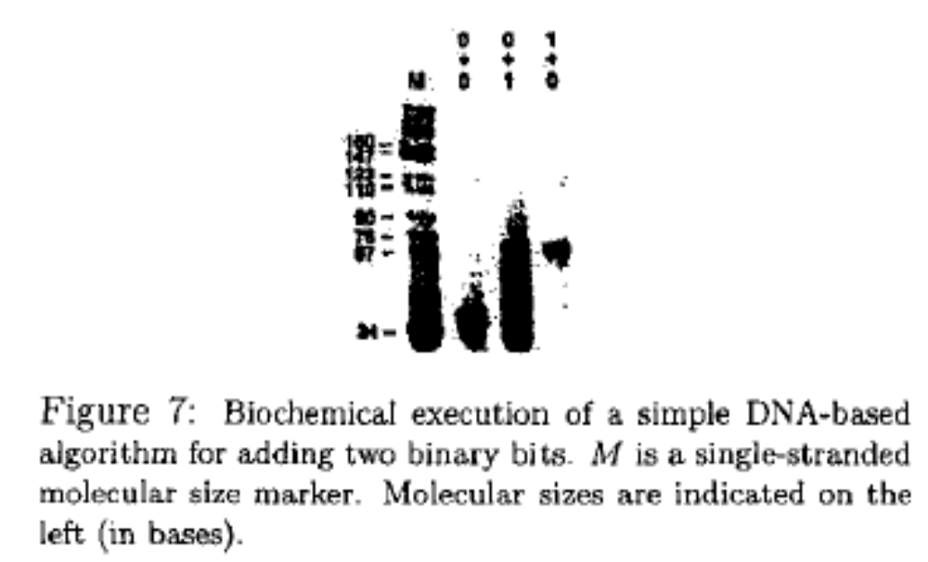
Simulation(1)

Slide 10
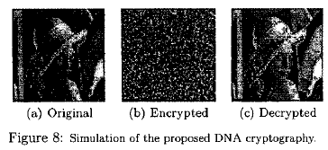
Simulation(2)

